Slide 1

Who is balena?

Slide 2
IoT hardware, software, and services organization
Mission is to remove friction for developers building IoT projects

Slide 3
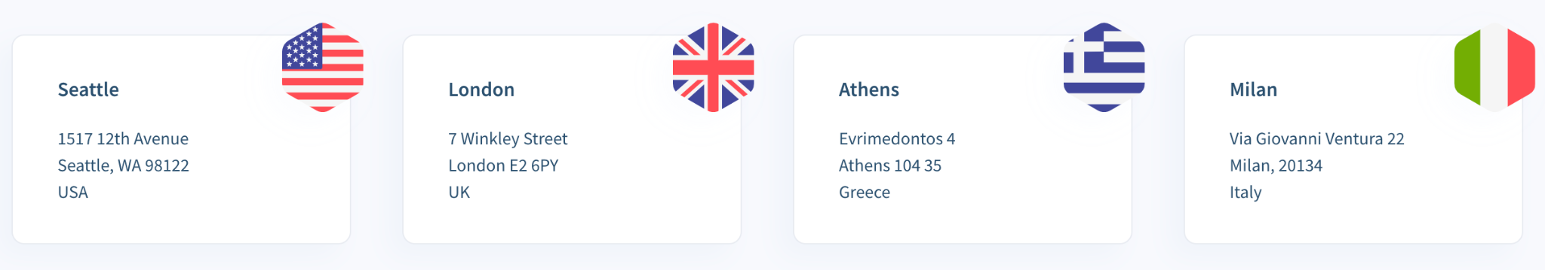
Balena is a Remote-First Organization…

Slide 4
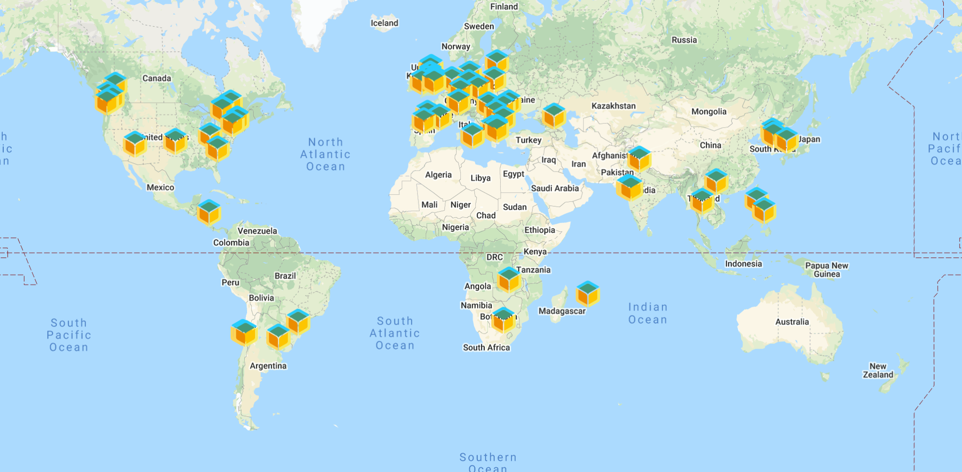
…With ~100 Team Members Across the Globe

Slide 5
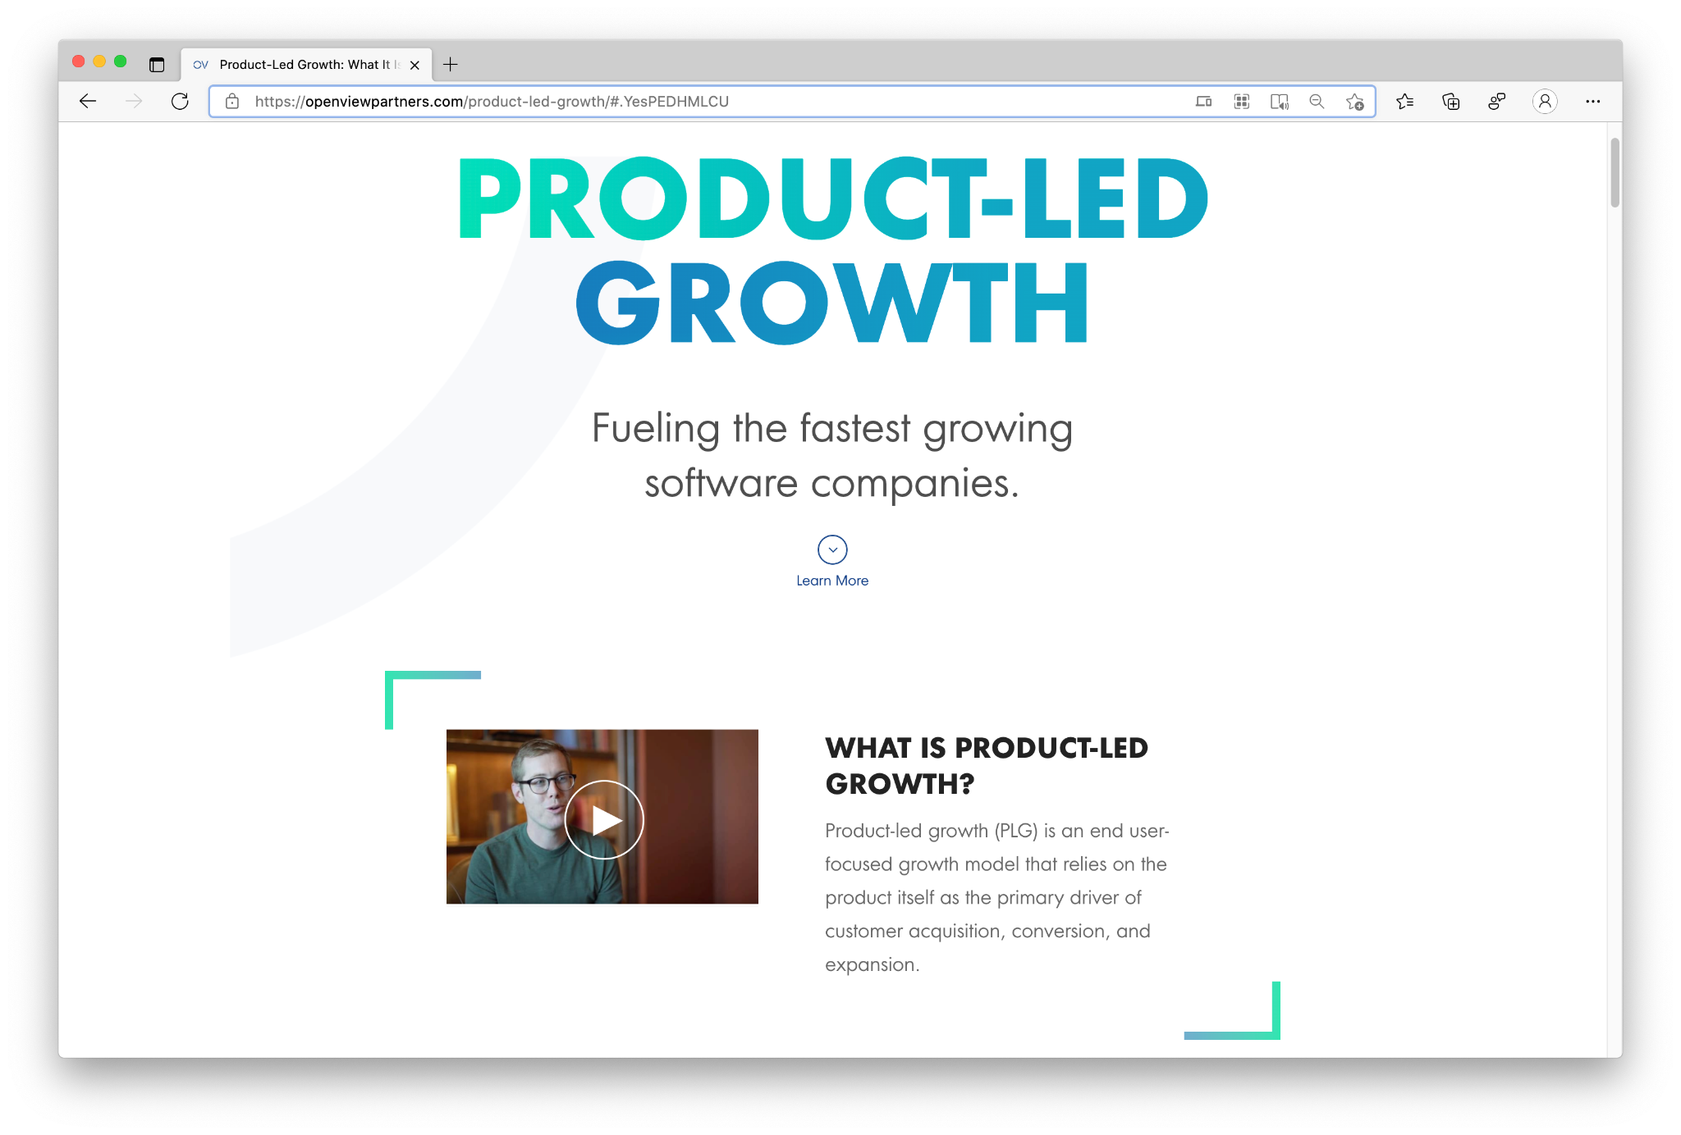
Balena is a Product-Led Growth Company…

Slide 6
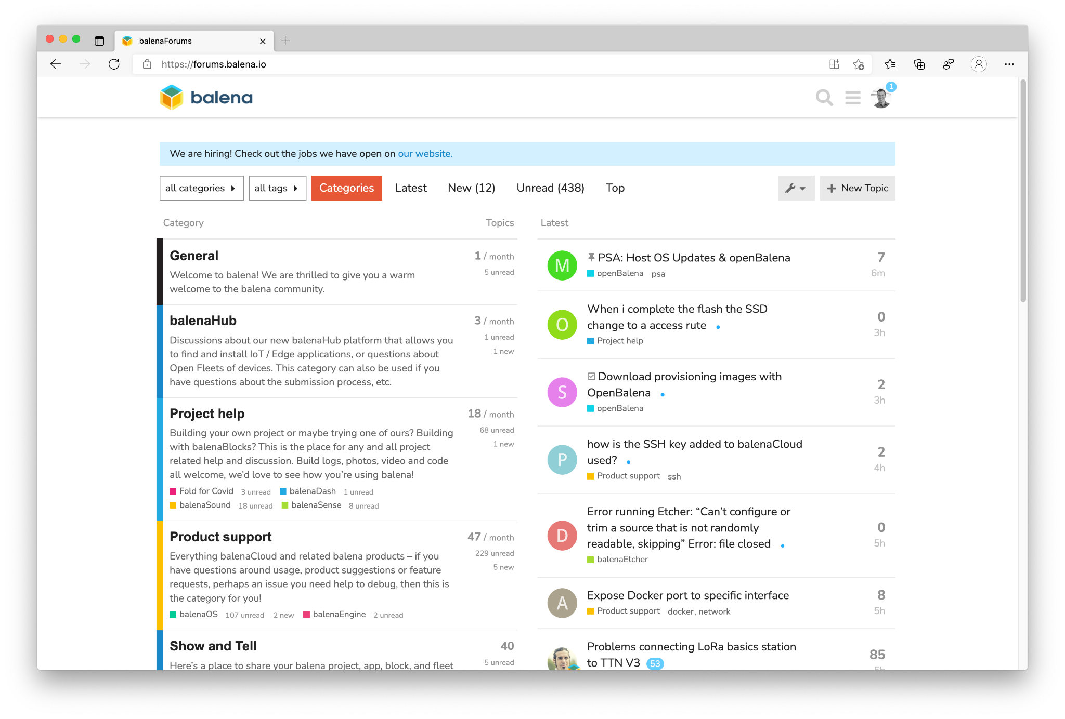
…With Support-Driven Development Guided By:
Customers
Community Members
Team Members

Slide 7
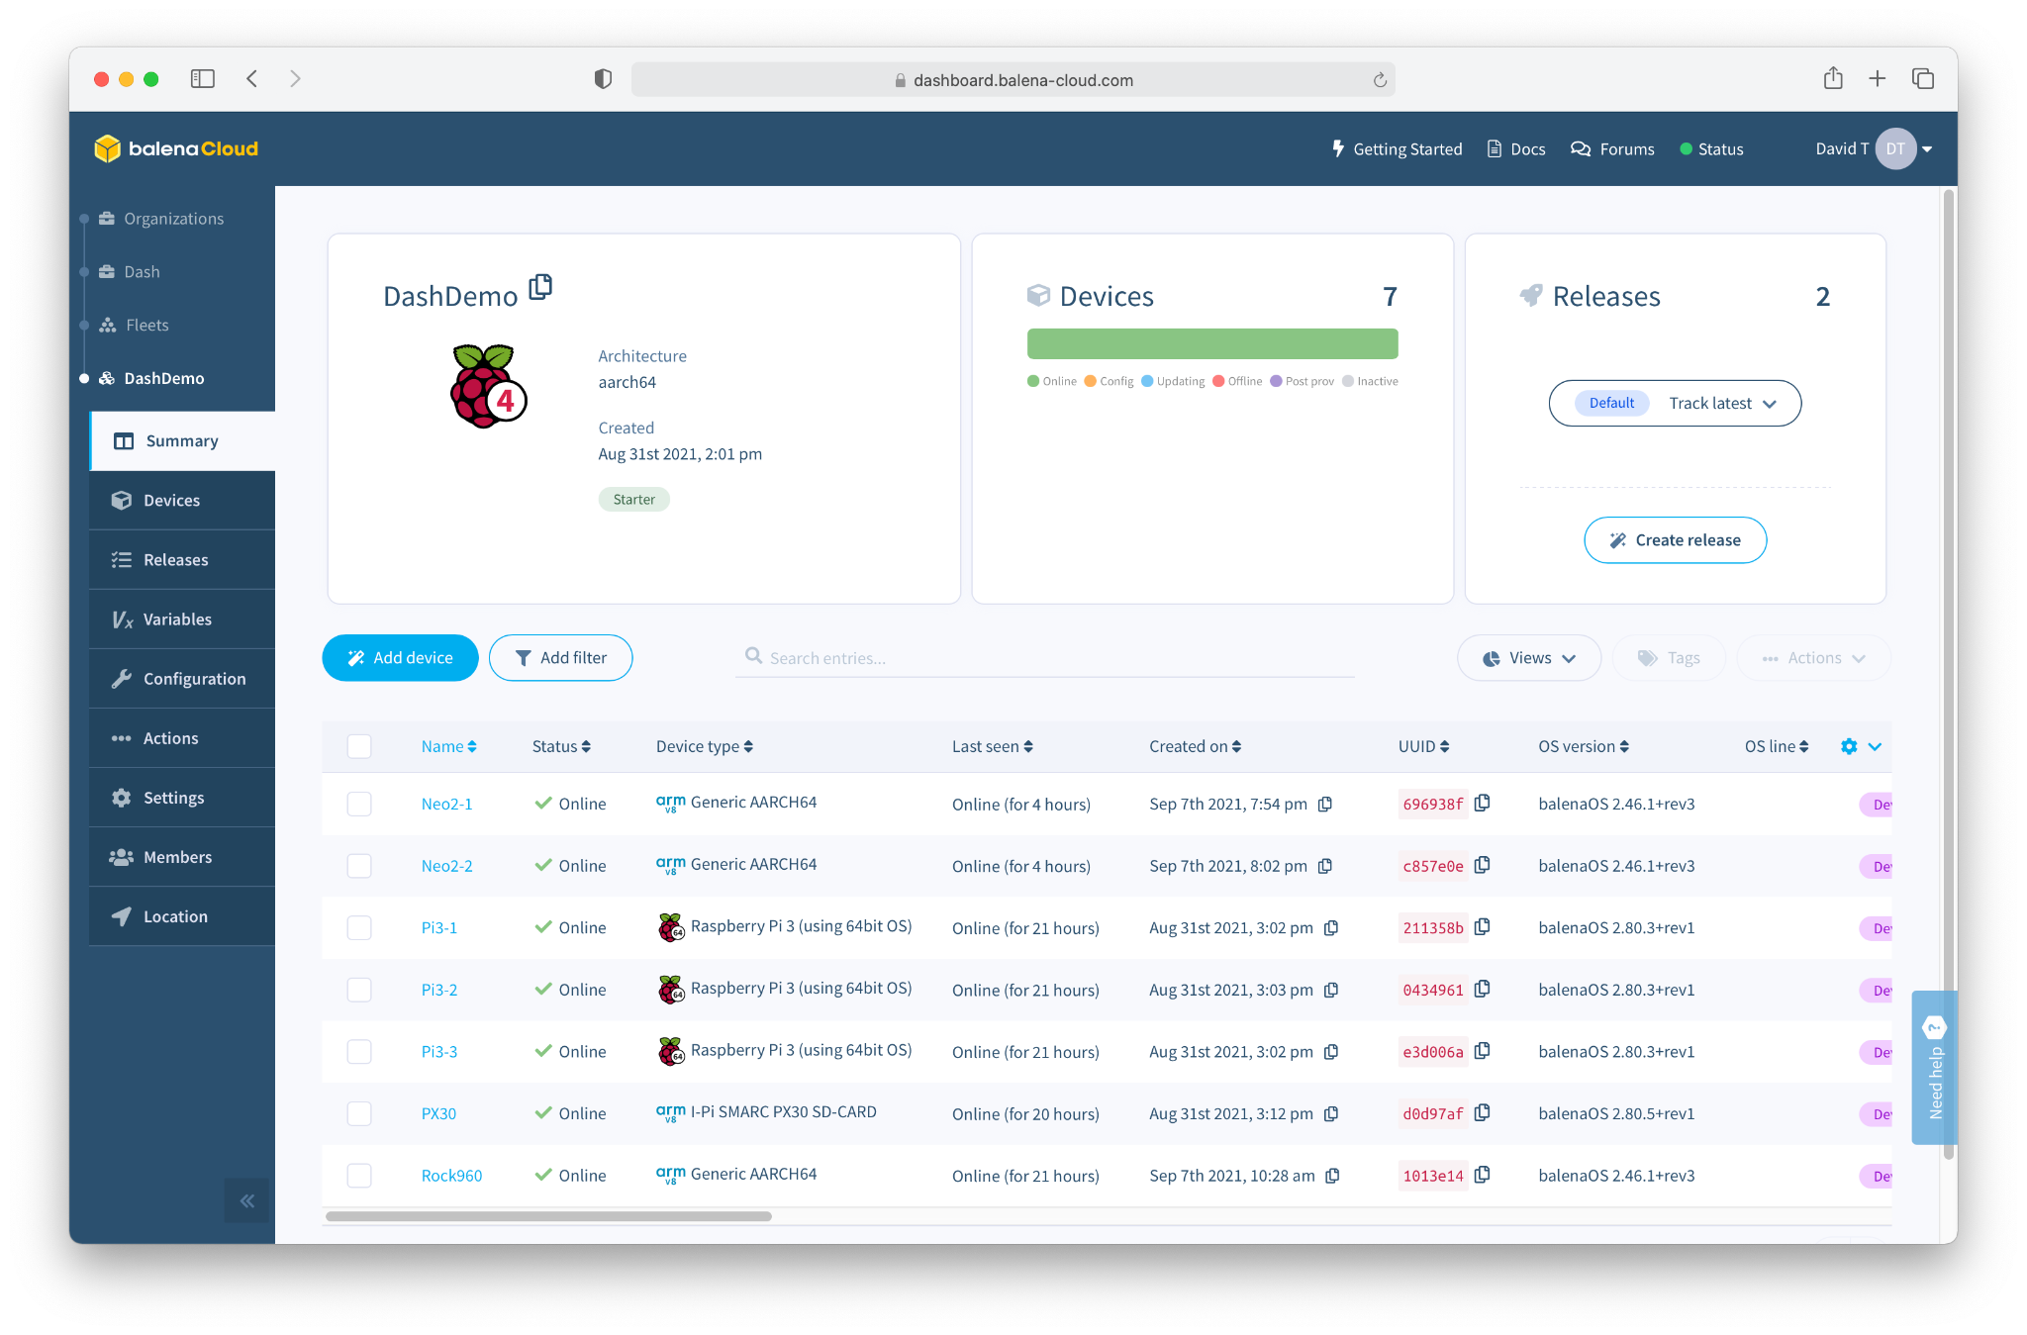
Software
balenaCloud
“Platform built to develop, deploy, and manage fleets of connected devices at scale.”

Slide 8
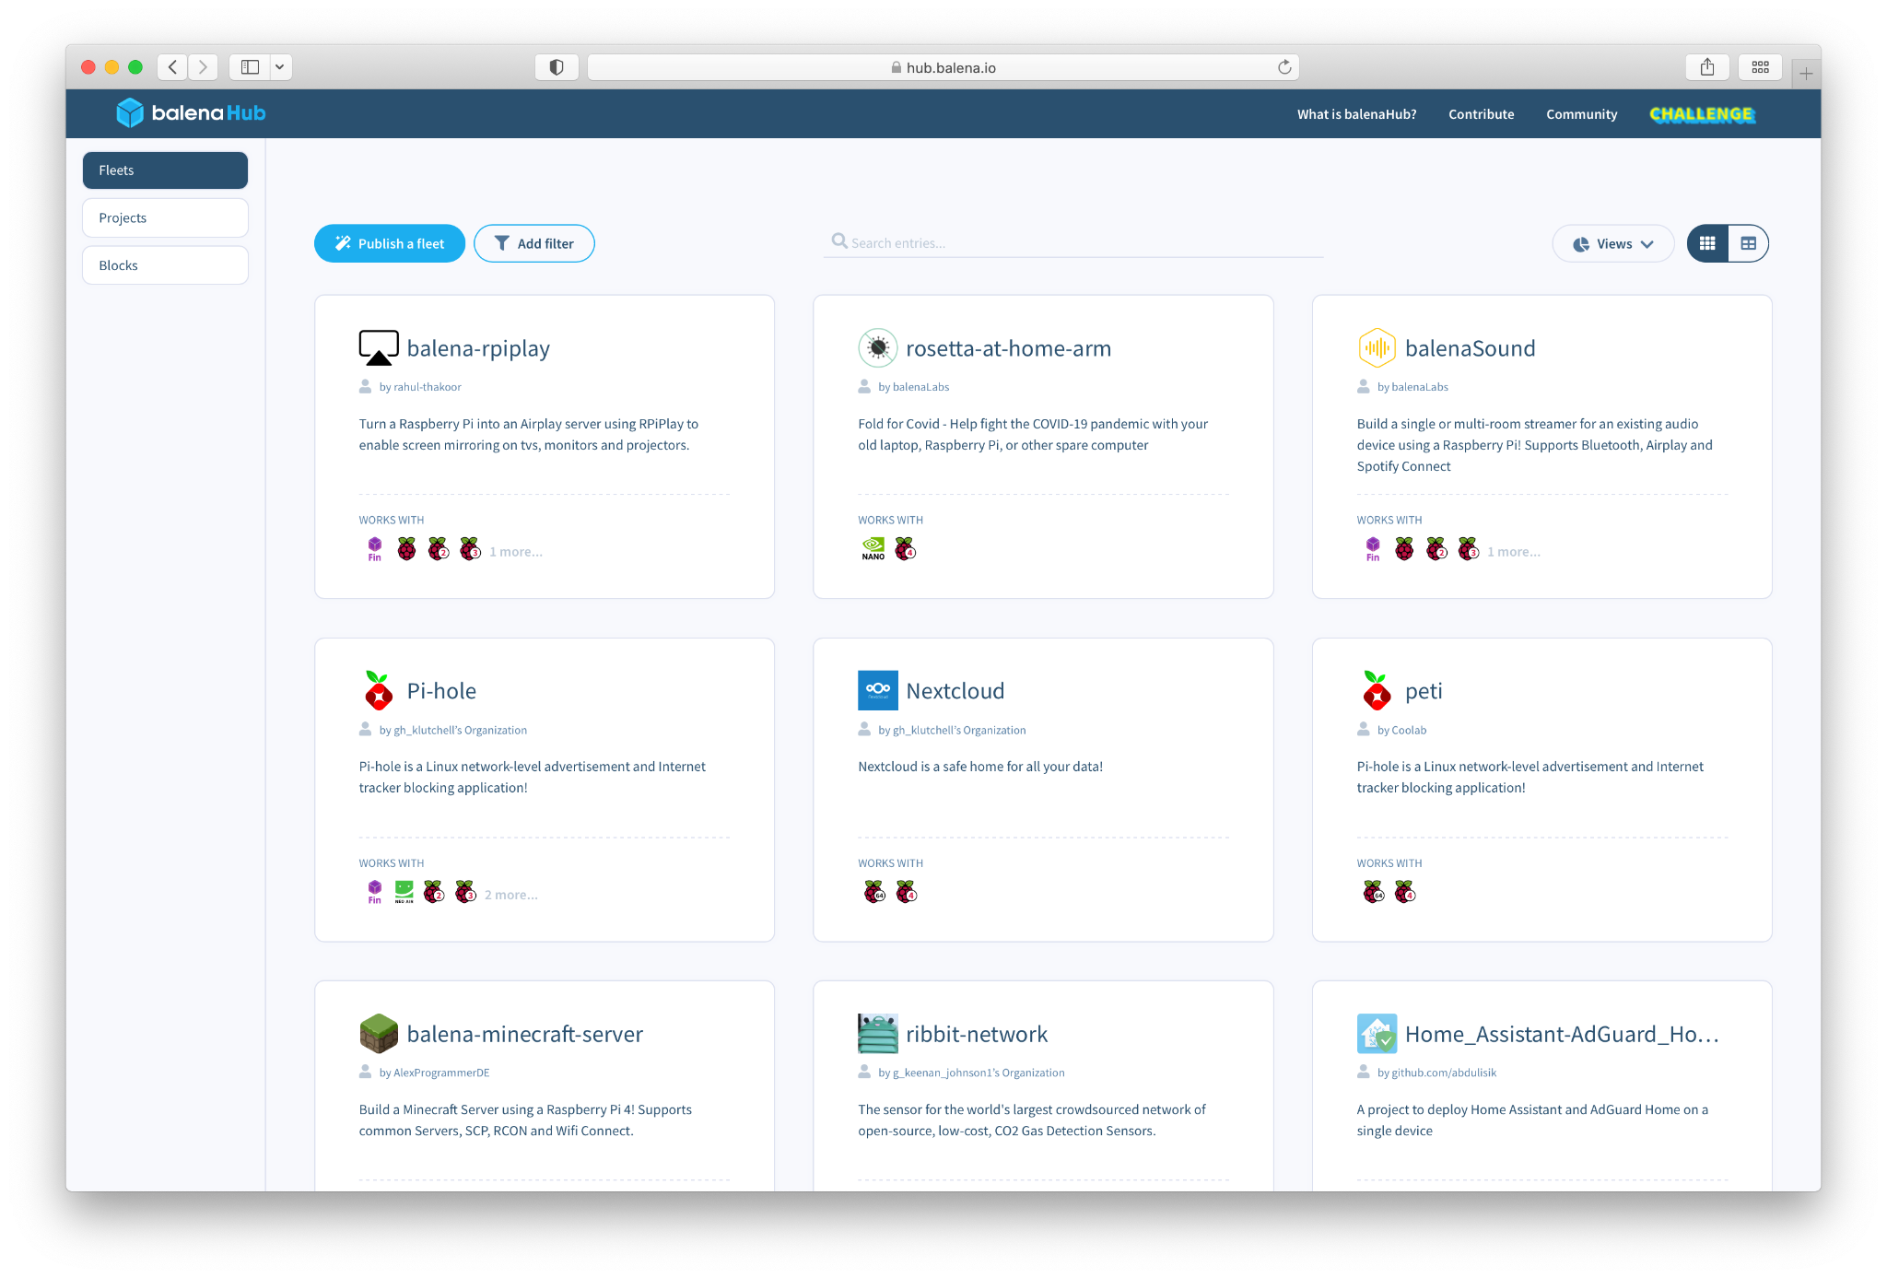
Software
balenaHub
“An easier way to find and publish fleets and projects for edge devices”

Slide 9
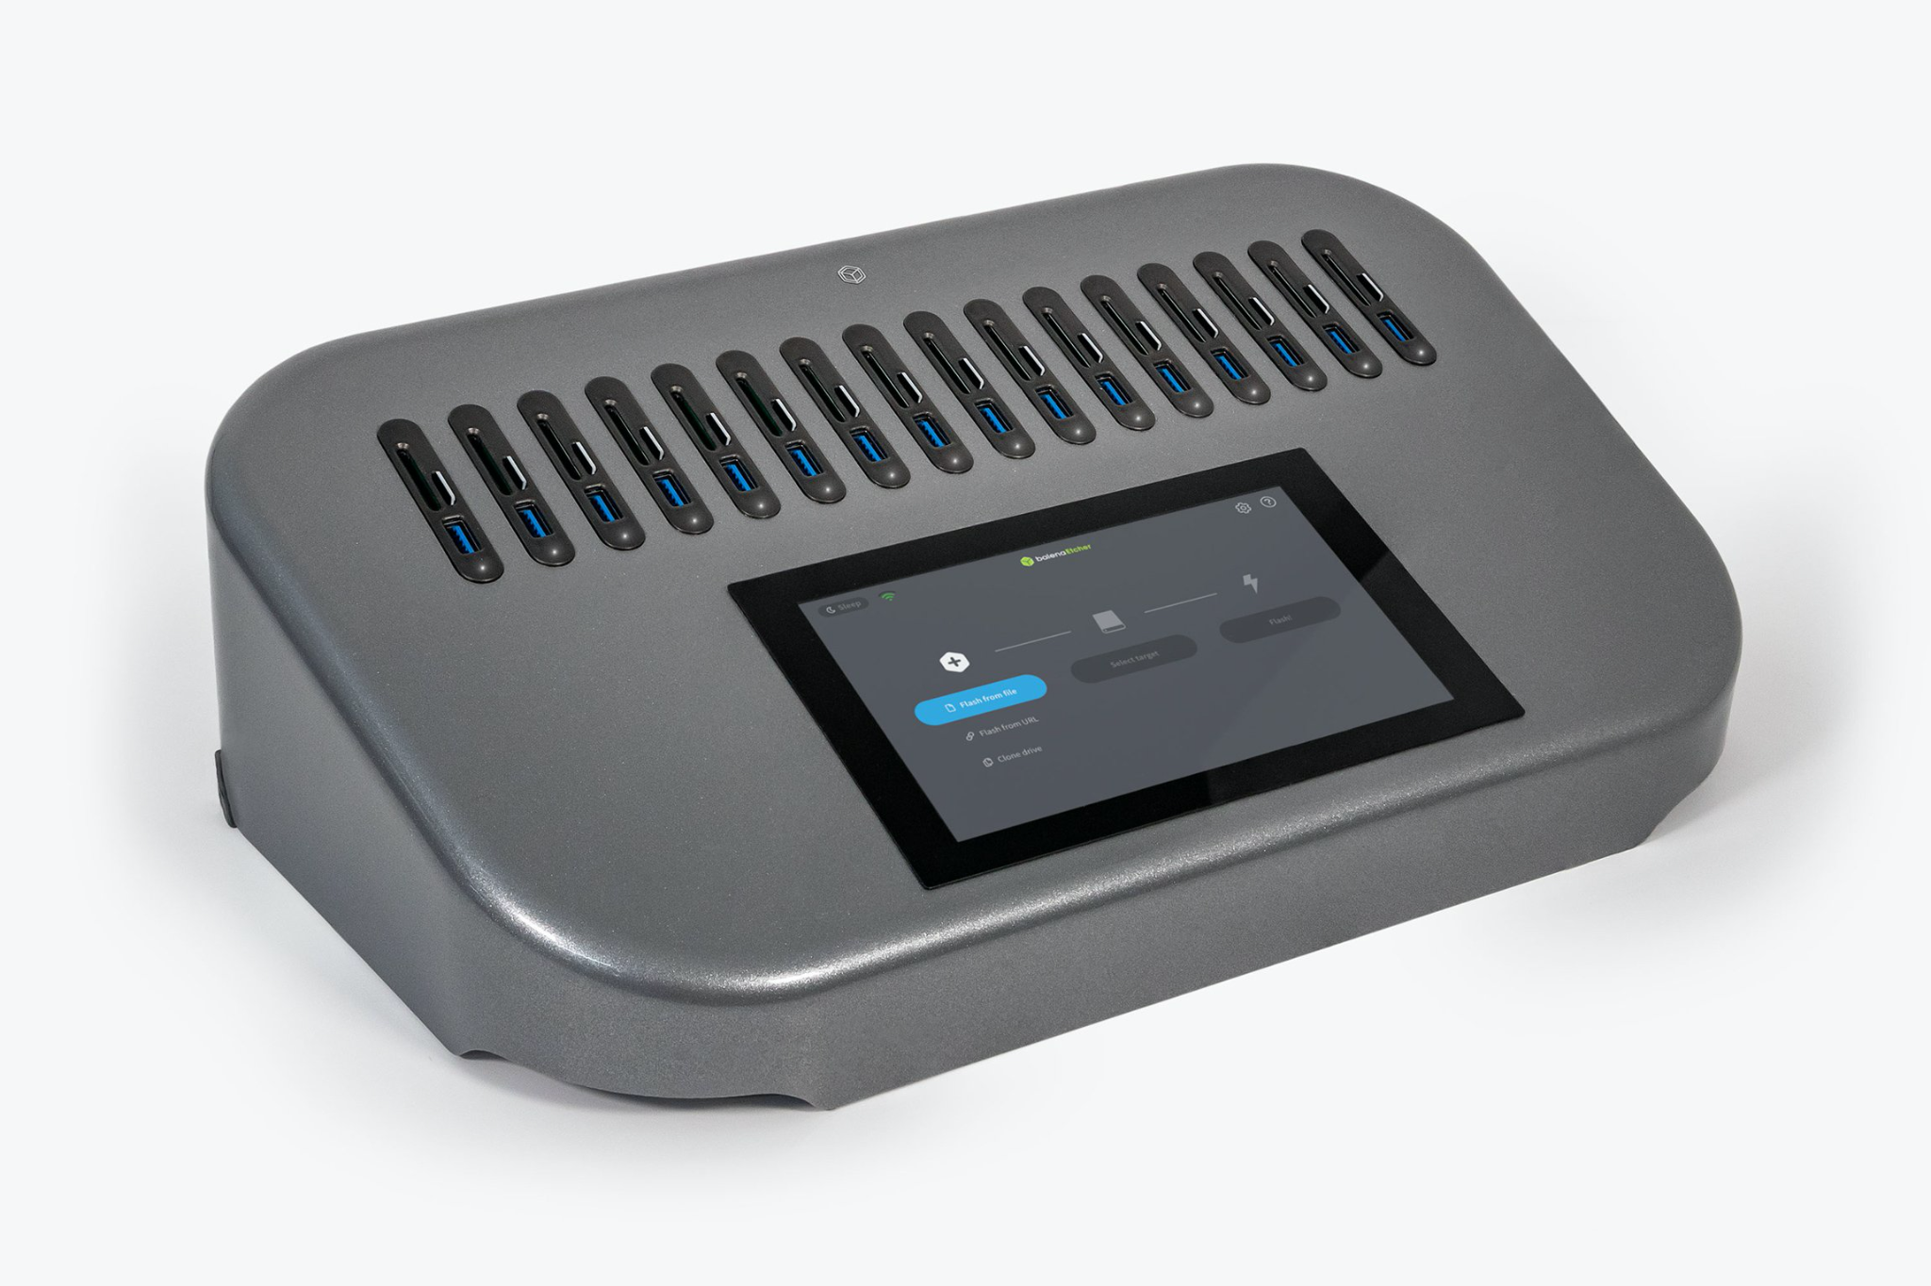
Hardware
EtcherPro
“Built to write data flawlessly to multiple devices simultaneously”

Slide 10
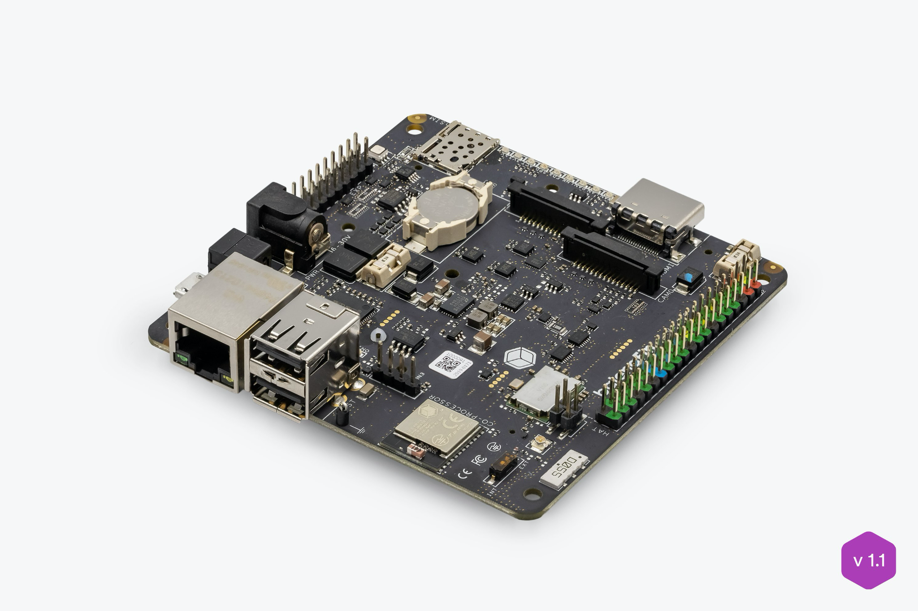
Hardware
balenaFin
“A professional carrier board for the Raspberry Pi Compute Module”

Slide 11
Questions?

Slide 12


